Slide 1
Introduction to Web Development track INSTRUCTOR : OMAR REDA Check point presentation

Slide 2
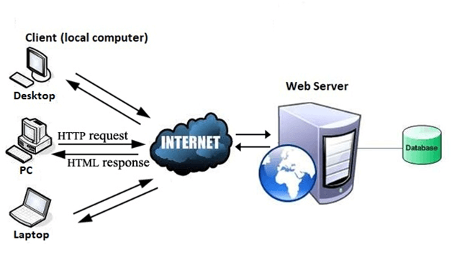
HOW DOES THE WEB WORK ?
The web, which is short for World Wide Web, is one of the ways information is shared on the internet (others include email, File Transfer Protocol (FTP), and instant messaging services). The web is composed of billions of connected digital documents that are viewed in a web browser, such as Chrome, Safari, Microsoft Edge, Firefox, and others.
Web pages are connected using Hypertext Transfer Protocol (HTTP), the coding language that allows you to visit any public web page. By clicking a hyperlink or entering a Uniform Resource Locator (URL), the browser uses this unique address to find and access a web page

Slide 3

What do you need to be a web developer?
You should have experience of - elements such as:
Coding languages including HTML and CSS
Frontend web programing languages and skills such as JavaScript, Ajax and web animation techniques
Backend web programing languages such as C# or Java, PHP and Ruby

Slide 4
What is the rule of the web develober ?
web developers essentially make a website work by building the functionality, interactivity and visible structure of the site, normally based on the vision of designers and other key roles.
Web developers are also responsible for ensuring a site functions correctly on all browsers - both desktop and mobile - through testing. Once a site is live, a developer carries out updates and other maintenance tasks as necessary.

